Slide 1

Spring AOP
Aspect-Oriented Programming with Spring

Slide 2
Table of Contents
‣Why Aspect-Oriented Programming?
‣ Basic AOP Concepts
‣ Getting Started with Spring AOP
‣ Beneﬁts and Drawbacks
‣When to Use Spring AOP?

Slide 3

Aspect-Oriented Programming (AOP) enables modularization of crosse cutting concerns

Slide 4

Cross-cutting Concerns
‣Logging ‣Validation ‣Transaction
Management ‣Security ‣Caching

Slide 5

Code Tangling
Coupling of different concerns

Slide 6

Code Scattering
Same concern spread across modules

Slide 7
The encouraged approach for implementing cross-cutting concerns

Slide 8

The encouraged approach for implementing cross-cutting concerns

Slide 9
1. Solve core problem
The encouraged approach for implementing cross-cutting concerns

Slide 10

1. Solve core problem
The encouraged approach for implementing cross-cutting concerns

Slide 11
1. Solve core problem
2. Write aspects
The encouraged approach for implementing cross-cutting concerns

Slide 12

1. Solve core problem
2. Write aspects
The encouraged approach for implementing cross-cutting concerns

Slide 13
3. Weave at runtime 1. Solve core problem
2. Write aspects
The encouraged approach for implementing cross-cutting concerns

Slide 14
AOP Terminology
‣An aspect is a module that encapsulates advice and pointcuts
‣An advice is code to be executed at a join point selected by a pointcut
‣A pointcut is an expression that selects one or more join points
‣A join point is a point in the execution of a program

Slide 15

Spring AOP
Java-based AOP framework

Slide 16
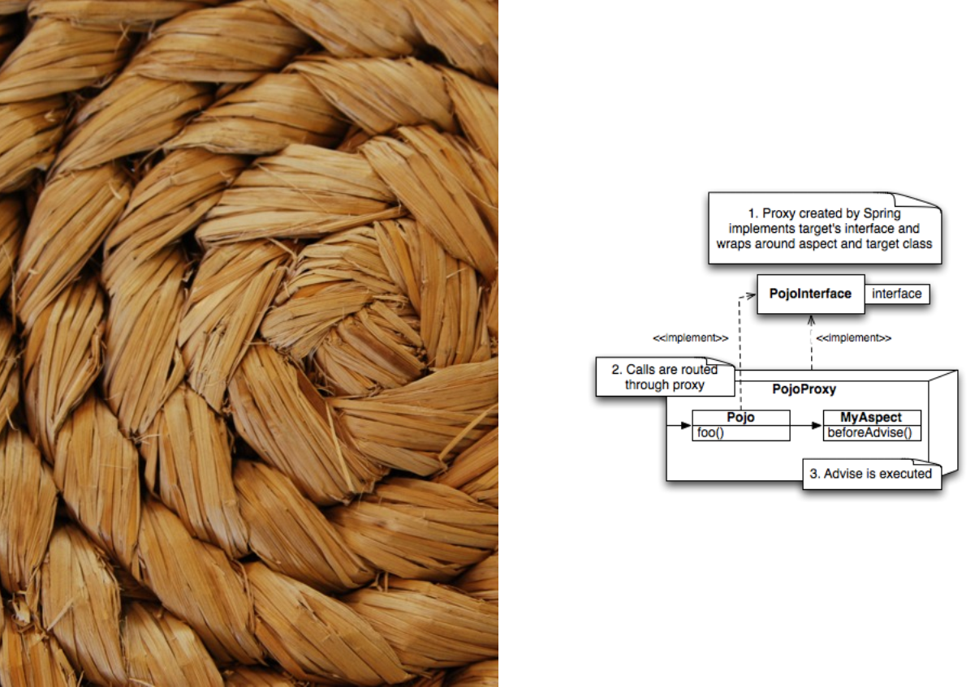
Spring uses dynamic proxying for aspect weaving

Slide 17
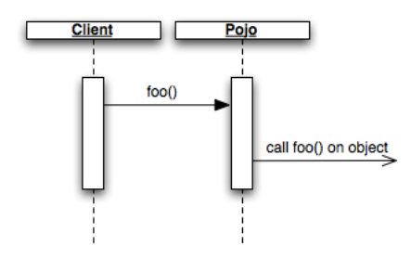
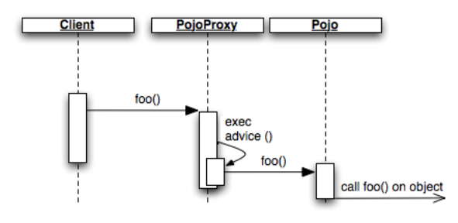
Regular method invocation
Proxied method invocation
Calls on the object reference will be calls on the proxy and the proxy delegates to all of the relevant advices

Slide 18






Spring offers 3 ways to accomplish AOP support
Annotation based with AspectJ | Schema based with AspectJ | Schema based without AspectJ
Very easy to conﬁgure | Bloated conﬁguration | Easy to conﬁgure
Horizontal class relationships at code level | Horizontal class relationships at deployment level | Horizontal class relationships at deployment level
Degrades portability | Enables portability | Enables portability

Slide 19

Conﬁguration
Schema based aspect conﬁguration without AspectJ

Slide 20
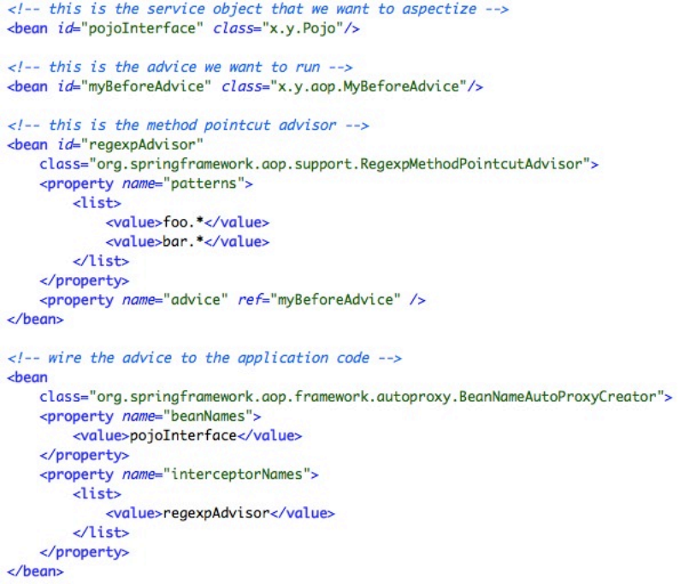
Sample XML conﬁguration

Slide 21
Demo

Slide 22

Beneﬁts
No special compiler required to allow per-object interception

Slide 23

Drawbacks
Lower performance

Slide 24
AOP Suitability
Concern
Logging | V | V | V | V |  | V
Validation | V | V | V | V | V | V | V | ?
Transaction Management | V | V | V | V | V | V | V | V
Security | V | V | V | ? |  | V | ? | ?
Caching | V | V | V | ? | ? | V | ? | V
Code reduction
Cost-effectiveness
Aspectizability
Crosscutting
Obliviousness
Evolvability
Modularity
Reliability

Slide 25



Modularization of cross cutting concerns
Schema based aspect conﬁguration
Auto-proxying for aspect weaving
Summary

